Slide 1


Predicting Bank-Loan Defaults Using Logistic Regression
Group 1, Case Study 2
Brianna Palmisano, Ava Rice, & Julianna LoMonte
St. John’s University, The Peter J. Tobin College of Business
Fall 2024
ThePhoto by PhotoAuthor is licensed under CCYYSA.
Notes:
Include Introduction on this slide, introduce both the project and ourselves

Slide 2
Introduction
This evaluation uses loan default data from the financial industry to examine the relationship between various customer and financial metrics, aiming to identify key predictors of loan default.
Understanding the factors behind loan defaults not only enhances credit risk management but also supports data-driven decision-making in loan approvals, interest rate setting, and customer support to mitigate financial risk.
As a core function in finance, managing loan defaults is essential for maintaining profitability and regulatory compliance in the industry.
This analysis applies descriptive statistics, correlation, and logistic regression to examine the likelihood of default and improve predictive accuracy using R.

Slide 3
Overview of the Banking Industry
Default prediction is critical for managing risk in financial institutions, especially with rising loan volumes.
Predicting default accurately helps banks minimize financial losses and optimize their lending strategies.
Growing reliance on data analytics and machine learning for credit risk assessment.
Logistic regression is widely used for binary classification problems like default prediction.

Slide 4
Table of Variables
Default Car_loan Personal_loan Home_loan Education_loan Gender Marital_status Emp_status Checking_amount Term Credit_score Amount Saving_amount Emp_duration Age No_of_credit_acc | Customer has defaulted (Target variable) (0 = No default, 1 = Default) Customer has a car loan (0 = No, 1 = Yes) Customer has a personal loan (0 = No, 1 = Yes) Customer has a home loan (0 = No, 1 = Yes) Customer has an education loan (0 = No, 1 = Yes) Gender of the customer (e.g., 0 = Female, 1 = Male) Marital status (e.g., 0 = Married, 1 = Single) Employment status (e.g., "employed" vs. "unemployed") Amount in the checking account Loan term in months Customer's credit score Loan amount in dollars Savings account balance in dollars Employment duration in years Age of the customer in years Number of credit accounts held by the customer
BINARY
CATEGORICAL
CONTINUOUS

Slide 5


Exploratory Data Analysis
We first analyzed the structure of the dataset, then confirmed that there are no missing or 'NA' values present. This dataset contains 1,000 observations and 16 variables.
Descriptive Statistical Analysis provides us with an overview of the key continuous variables in the dataset, revealing some patterns or potential indicators of loan default risk...
Checking Amount shows a wide range, indicating that some borrowers may have limited financial stability while others are financially robust. Borrowers with negative balances may be at a higher risk of default due to their financial strain.
Loan Term has a range from 9 to 27 months, showing that loan durations vary, potentially reflecting differing repayment capacities or risk assessments made by the bank.
Credit Score shows a broad range from 376 to 1029. Generally, higher credit scores may correlate with lower default risk, while lower scores might suggest financial challenges.
Savings Amount and Employment Duration has a range from around $2,000 to $4,100, with lower savings potentially linked to higher default likelihood.
Employment Duration varies widely as well, with longer durations possibly indicating stable income, which may be associated with a lower likelihood of default.

Slide 6
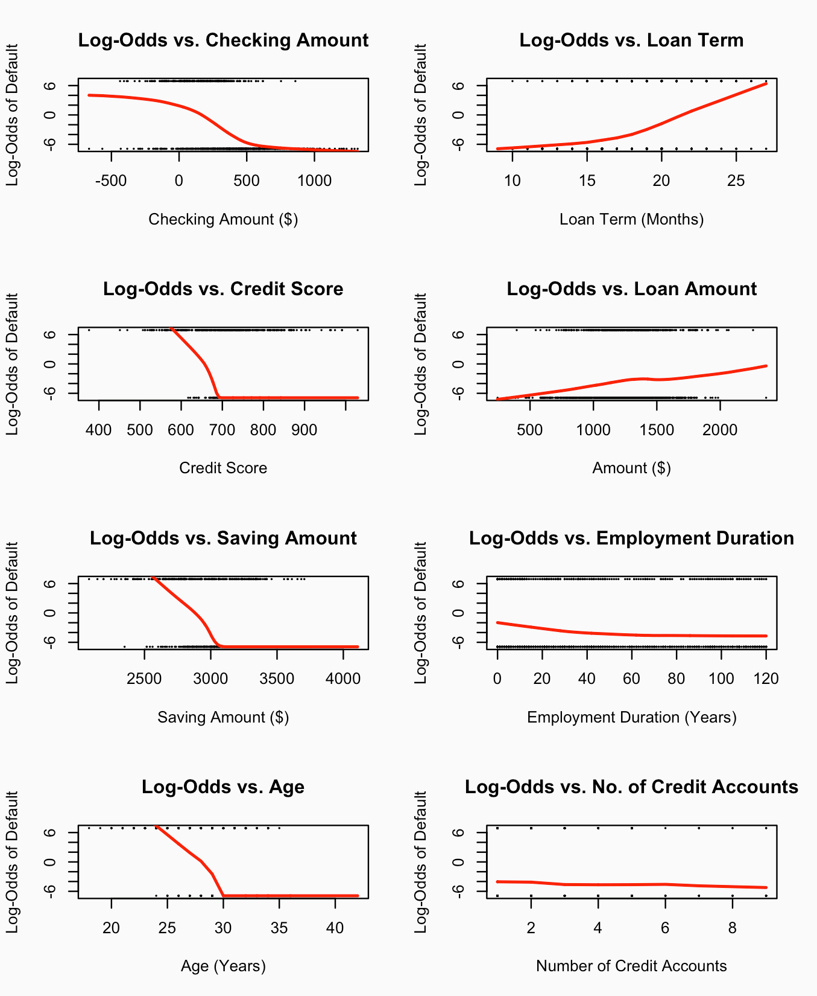
Assumption Check – Linearity of Predictors with Log-Odds
The Default or target variable has been transformed into log-odds, then plotted against each predictor to check the linearity of our predictor variables, relative the response variable.
These were the key observations...
Checking Amount and Savings Amount: Both show a noticeable downward trend with log-odds, suggesting that higher account balances correlate with lower odds of default.
Credit Score: A negative relationship is evident, with higher credit scores aligning with lower default log-odds, shoing that borrowers with stronger credit histories pose lower default risk.
Loan Term: Displays a positive relationship with log-odds, meaning longer loan terms are associated with higher default odds, potentially reflecting increased financial strain over extended repayment periods.
Age and Employment Duration: Both show weaker trends with the log-odds, though younger age and shorter employment duration might still suggest higher default risks, hinting at lower financial stability.

Slide 7
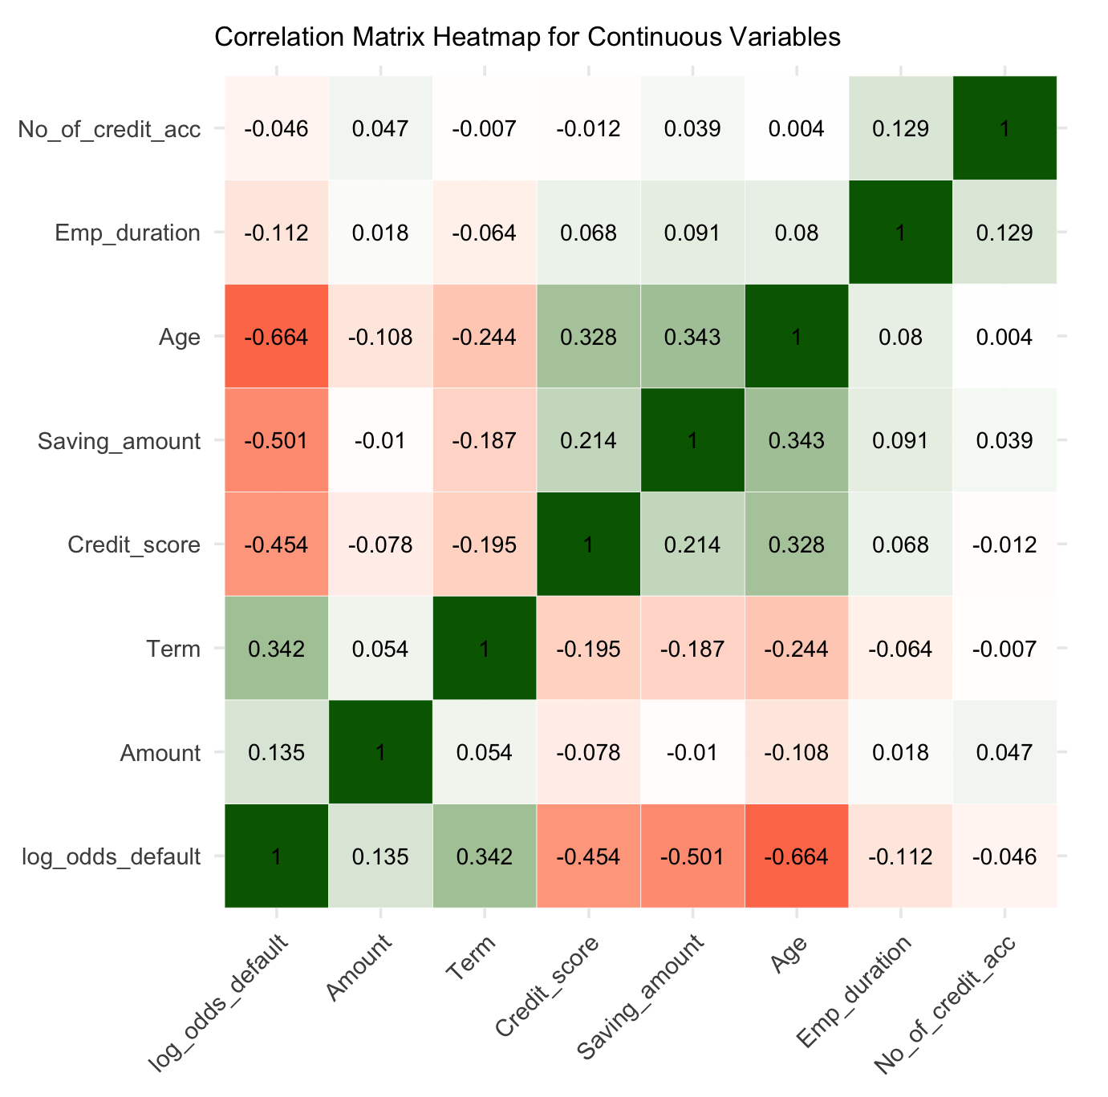
Correlation Analysis
Like the initial logistic model built, a Correlation Matrix was drafted to visualize the associations between all continuous predictor variables and the log-odds of the response variable, Default.
All predictors show low log_odds_default correlation coefficients, though these were the highest associations.
Age shows a strong negative correlation and the most explanatory power at -0.664, suggesting older individuals are less likely to default on loans.
Term has a positive correlation at 0.342, meaning longer loan terms might be associated with a higher default risk.
This matrix helps identify any strong relationships between variables, guiding decisions on feature selection and multicollinearity for modeling.

Slide 8
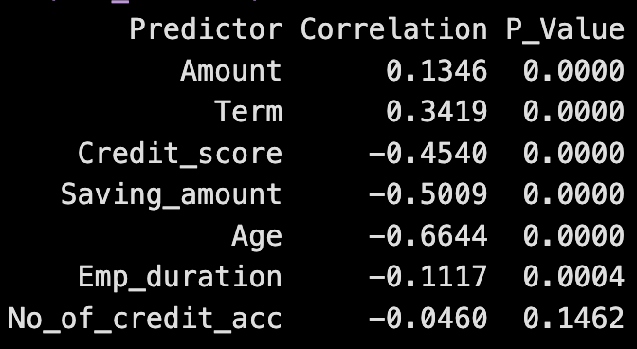
Correlation Testing
To determine whether the correlation (pearson momne tcorrelation) between variables is significant, we need to compare the p value to the significance level (0.05).
This table presents the correlation coefficients and p-values for each continuous predictor variable in relation to the target variable.
Most variables, except for Number of Credit Accounts, show statistically significant correlations with the default variable (p-values < 0.05). This indicates that they are potentially meaningful predictors of default.
The significant correlations with higher absolute values (like Age, Saving Amount, and Credit Score), should be prioritized in the model, while Number of Credit Accounts may have limited predictive value.

Slide 9

Methodology
Logistic regression models are used for binary classification problems, such as predicting the probability of a loan default. Unlike linear regression, logistic regression estimates the probability of a binary outcome, P, as a function of the predictors.
Logistic regression first calculates the odds of an outcome using the Odds Equation below. This represents the likelihood of default relative to non-default.
Odds = e(β0 +β1 x1 +β2 x2 +... )
This formula transforms a linear combination of predictors into a probability value between 0 and 1, suitable for binary outcomes. Each predictor's coefficient (β) reflects its contribution to the probability of default. In the Probability Equation below, positive coefficients increase P, while negative ones decrease it.
P = 1/1+e−(β0 +β1 x1 +β2 x2 +...)
Using the Log-Odds (Logit) Transformation, logistic regression transforms the probability into a linear function of the predictors by taking the natural log of the odds.
log(P/1−P)=β0 +β1x1 +β2x2 +...
Logistic regression is suitable for this analysis as it allows us to interpret the effects of predictor variables on the probability of a loan default, making it ideal for assessing credit risk in the financial industry

Slide 10
Building the Model
To evaluate our model, we created two versions including an initial model with all predictors, which was refined to exclude non-significant variables. Based on linearity assessments, correlation coefficients, and p-value significance, the final model includes the predictors: Checking amount, Term, Credit score, Employment status, Saving amount, and Age.
The equation below represents our final logistic regression model in the log-odds form with specific coefficients for each predictor...
log(P / (1 – P)) = 39.0372 - 0.0048 * x1 + 0.1752 * x2 - 0.0116 * x3 + 0.5068 * x4 - 0.0046 * x5 - 0.6321 * x6
Wald Testing
The purpose of this testis to measure the significance of individual predictors included in our model. Using the Wald test results helps refine the model by identifying which variables meaningfully contribute to the prediction.
Significant variables retained in the model add predictive power. Non-significant variables, if removed, can streamline the model without sacrificing accuracy. In practice, this step improves the model’s interpretability and may enhance performance by reducing multicollinearity and overfitting.
Our results for this test confirmed that our variables selection process was successful, as all variables are proven significant here. There is no reason to continue to remove any of our predictors, before entering the model validation process.
x1 = Checking_amount
x2 = Term
x3 = Credit_score
x4 = Emp_status
x5 = Saving_amount
x6 = Age

Slide 11
Data Splitting for Model Validation
Train-Test Split
The data was split into 70% training and 30% testing for validation purposes. This insists that there are 700 observations in the training set, leaving 300 for the test set.
The split ensures that the model is built on one subset and validated on another, so that the model’s performance is evaluated on unseen data and providing a realistic estimate of accuracy. By using separate sets, the model avoids learning only the training data patterns, ensuring it can generalize well to new data.
Here, each predictor independently contributes to the model without redundancy.

Slide 12
Multi-collinearity Testing
Multi-collinearity can be devastating to a model's performance. When predictor variables are too correlated with one another, we can assume they may be capturing similar information. We use Variance Inflation Factor (VIF) Testing to look for redundancies in our model.
VIF test scores range from 1 to 10. Where 1 represents our predictors having no correlation with one another, and 10 meaning the independent variables are highly correlated.
Though our exploratory data analysis have checked for multi-collinear pairs, all variables have a low VIF score (below 2 and close to 1) as well. There is minimal concern for multi-collinearity between predictor variables in this model.

Slide 13
Model Fit Evaluation
Hosmer-Lemeshow Test
Hosmer-Lemeshow is used to assess the goodness-of-fit in logistic regression models, evaluating whether the observed event rates match the predicted probabilities across subgroups of data.
A higher p-value (or one greater than the threshold, 0.05) indicates that the model's predicted probabilities are not significantly different from observed outcomes, suggesting a good model fit.
In this analysis, the test was conducted on the training dataset to verify that the model aligns well with the observed outcomes.
Here, the p-value exceeded 0.05 greatly (at 0.4), suggesting a good model fit and confirming that predicted default probabilities closely match the actual data.

Slide 14
Model Comparison
Likelihood Ratio Test
The Likelihood Ratio Test (LRT) evaluates if simplifying a model by excluding non-significant predictors significantly changes its ability to explain variation in the outcome.
This test compares the fit of our initial model (using all predictors) to the final model (using significant predictors only) in confirming that the refined model is as effective or not. Using only significant predictors can prevent overfitting.
Model 1 has a higher log likelihood (-106.82) than Model 2 (-124.72). The LRT produced a Chi-square value with a low p-value, suggesting that removing non-significant predictors results in a more efficient model, without sacrificing predictive performance.
Our refined model remains effective and efficient, offering predictive insight into loan defaults while reducing complexity.

Slide 15
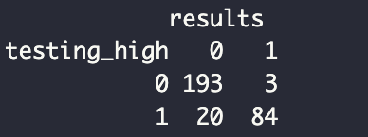
Model Validation: Predictive Performance
We applied a threshold of 0.7 to classify probabilities, ensuring that only predictions with a high likelihood of default are flagged as defaults. This threshold level prioritizes reducing false positives, allowing the model to more confidently identify high-risk borrowers. By setting this threshold, we adjust both our classification results, as well as our ROC Curve and AUC results.
The classification table compares the predicted to the actual outcomes. There were 193 true negatives, 84 true positives, 3 false positives, and 20 false negatives. After calculating the accuracy of the model, we see that it is about 92.3% accurate and has about a 7.7% misclassification error rate. This high accuracy indicates a low error rate, implicating strong model performance.
The also high precision (or, positive predictive value) at 96.6% tells us that the model us reliable in terms of predicting loan defaults. Precision is especially relevant in financial contexts where false positives (incorrectly predicting default) can impact customer relations and costs in other areas.
The recall for this model is considerably high at 80.8%, but does show that the model has some room for improvement in detecting a portion of true positive cases. This is crucial in lending, as missed defaults (false negatives) can increase financial risk.
We are doing both for completeness, but we are going to focus more on ROC Curve and AUC to assess model performance further.

Slide 16
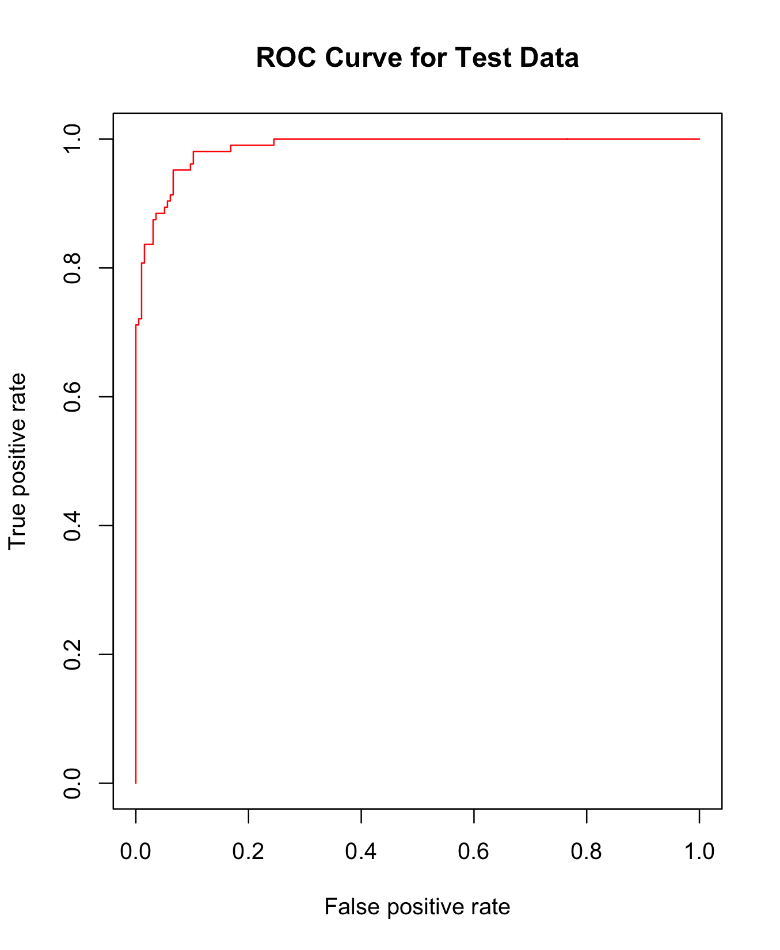
ROC Curve & AUC
The Receiver Operating Characteristic (ROC) Curve and AUC measure model performance.
The y-axis shows the true positive rate (TPR) or the sensitivity, and the x-axis shows the false positive rate (FPR). A curve towards or approaching 1 indicates the best performance of the model.
The ROC shows a high level of sensitivity and has a minimal FPR, while the AUC value indicates high model accuracy as well.
Based on the above criteria, we can conclude that this is a well performing model and confirm the model’s predictive strength. This model is distinguishing between default and non-default cases, effectively.
AUC = 0.986

Slide 17
Conclusion
In this case study, we effectively applied Logistic Regression to predict loan default probability based on financial and demographic factors.
Logistic regression is well-suited for credit risk modeling because it efficiently handles binary classification. Our refined model enhanced the accuracy of bank loan default predictions by focusing on critical predictors, including Checking Account Balance, Loan Term, Credit Score, Employment Status, Savings, and Age.
These findings can support banks and lenders in making more informed, data-driven lending decisions that contribute to reducing potential financial compromises experienced due to loan default.
This model contributes not only to bank stability and mitigating loss, but to the standard of responsible lending practices as well.
Future steps could enhance this model’s effectiveness, including additional data (predictors) and alternative machine learning approaches like decision-tree or random-forests that will allow for lenders to navigate these data-driven insights in a more dynamic way.

Slide 18

Thank you!

Slide 19
Bibliography
Gupta, D. (2018). Applied analytics through case studies using SAS and R: Implementing predictive models and machine learning techniques (1st ed.). Apress.
OpenAI. (2024). ChatGPT (October 30, 2024) [Large language model]. OpenAI. https://chat.openai.com.

